Slide 1


Slide 2


Slide 3

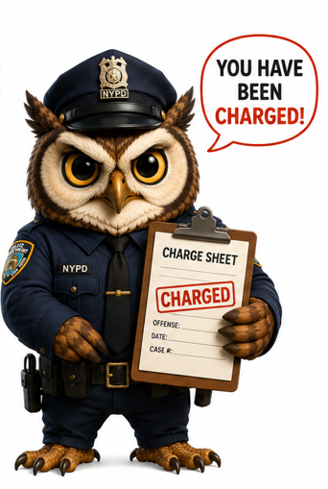
FS vs. FPS Deep Dive
The Fraud Support team handles two conversational case types:
FS (Fraud Support)
FPS (Fraud Penalty System)
Conversation involve property owners who have:
Received a Fraud Letter or Warning Letter.
Questions about the property's fraudulent history or current fraud penalties.
Had awards removed due to fraud.
Content integrity issues where:
No official notification (Fraud or Warning Letter) has been sent to the property.
The property is not under any penalty.
Tripadvisor / Fraud Support / FS vs. FPS Deep Dive

Slide 4

Case Types Handled: FS
FS Blackmail
FS Incentives
FS Bullying
FS Boosting
Owners claiming guests are demanding goods or services to avoid negative reviews
Properties offering or demanding goods/services in exchange for reviews.
Users reporting harassment from owners attempting to have reviews removed.
Users reporting properties writing reviews on their own.
Examples
Examples
Examples
Examples
FS Reverse Incentives
FS Review Disputes
FS Status of My Review
Users reporting properties offering goods/services in exchange for reviews.
User inquiries regarding why submitted reviews are not yet published.
Reviews being reported by owners or users
Examples
Examples
Examples
Tripadvisor / Fraud Support / Case Types Handled

Slide 5
FS Blackmail - Examples
An owner hints to a guest that a discount might be given if the review is positive.
An owner explicitly demands free services from a guest to avoid a negative review.
An owner threatens legal action or public shaming if a guest leaves a negative review without providing goods or services.
Tripadvisor / Fraud Support / Examples

Slide 6
FS Incentives - Examples
A property offers small complimentary items like snacks or drinks for reviews.
A property offers free room upgrades or discounts in exchange for positive reviews.
A property demands guests write positive reviews before allowing check-out or access to booked services.
Tripadvisor / Fraud Support / Examples

Slide 7
FS Bullying - Examples
An owner sends polite requests to a reviewer asking to reconsider or edit their review.
An owner sends multiple aggressive messages demanding the review be removed.
An owner uses threatening or harassing language, including personal attacks, to force the reviewer to remove their review.
Tripadvisor / Fraud Support / Examples

Slide 8
FS Boosting - Examples
An owner writes a positive review about their property without disclosing affiliation.
An owner or staff writes multiple fake positive reviews to inflate ratings.
An owner coordinates a network of fake accounts to post numerous fraudulent positive reviews to manipulate ratings.
Tripadvisor / Fraud Support / Examples

Slide 9
FS Reverse Incentives - Examples
A traveler reports a card in their room reading, "Leave a 5-star review for a free cocktail at the resort bar."
A tour operator promises a 25% refund on a safari via WhatsApp if the traveler shows proof of a positive review before checkout.
A boutique hotel refuses to refund a guest for a broken AC unless they actively post a 5-star rating during their stay.
Tripadvisor / Fraud Support / Examples

Slide 10
FS Review Disputes - Examples
A B&B owner disputes a 2-star review because the traveler complained about rain during their outdoor walking tour.
A restaurant owner flags a 1-star review written by a direct competitor's head chef located on the same street.
A resort reports a coordinated review-bombing campaign after a viral social media video, receiving hundreds of fake 1-star reviews from non-travelers.
Tripadvisor / Fraud Support / Examples

Slide 11
FS Status of My Review - Examples
A traveler asks why their review of a local cafe posted this morning is still showing as "Pending Moderation."
A high-tier community member wonders why all five reviews from their recent trip to Rome are blocked by the automated filter.
An active destination reviewer submits an urgent ticket because their entire review history has vanished, and new posts are instantly rejected.
Tripadvisor / Fraud Support / Examples

Slide 12
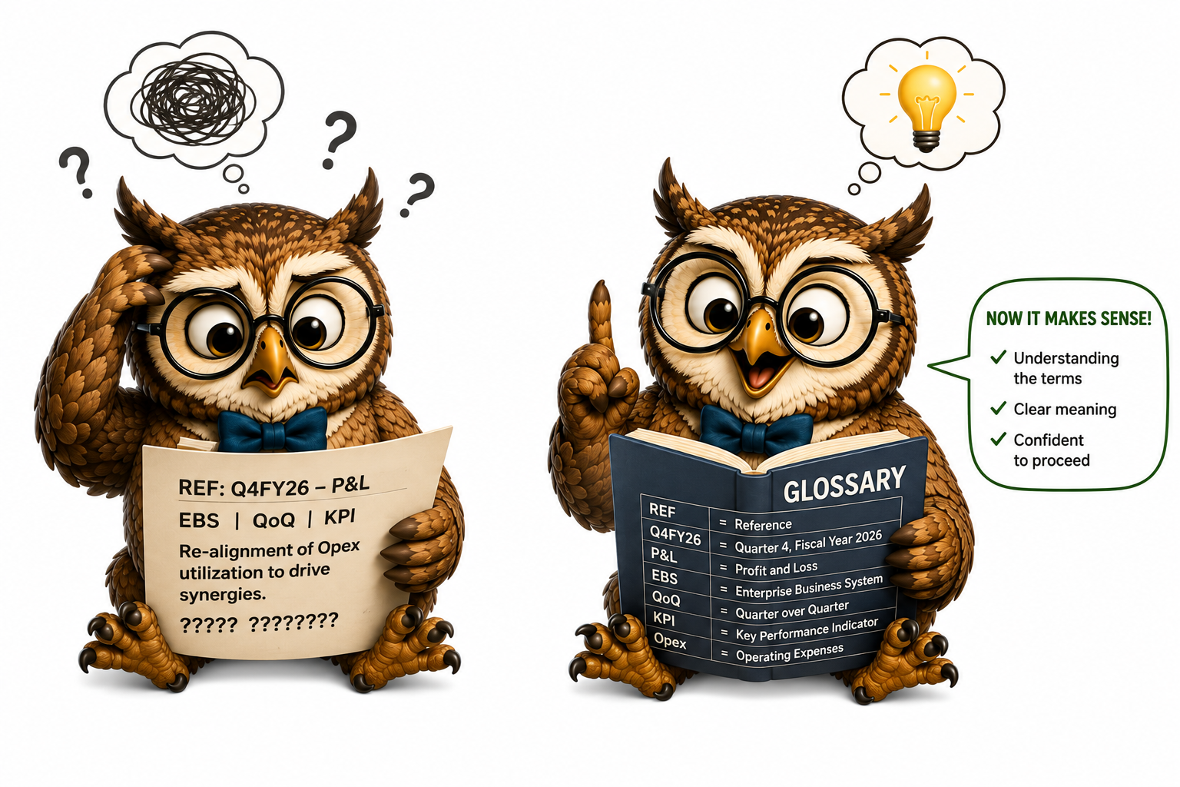
Refer to the ‘Glossary’ for Abbreviations
Tripadvisor / Fraud Support /Glossary

Slide 13
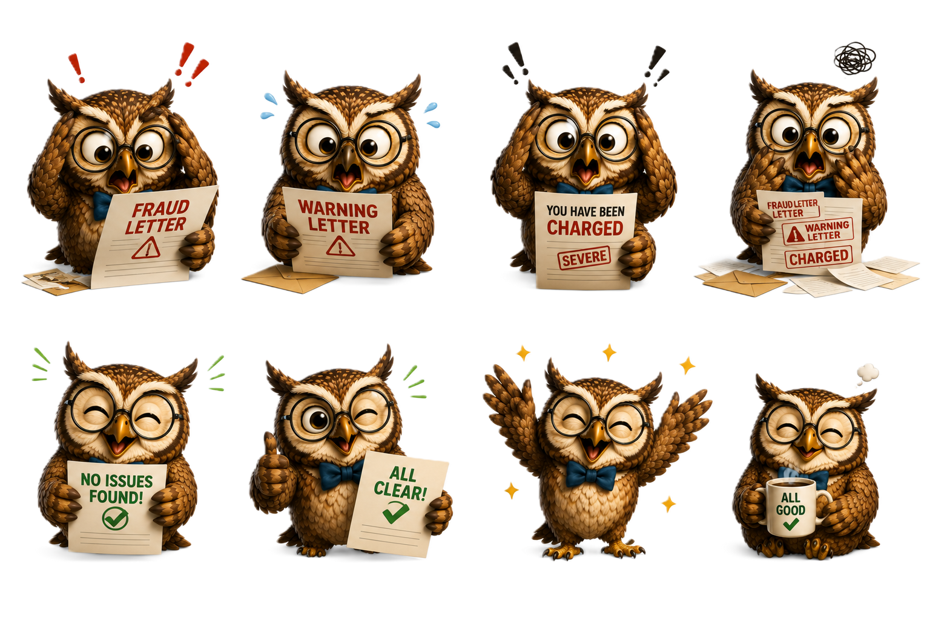

Case Types Handled: FPS
Fraud Letters
Warning Letters
General CI Questions
Conversation stemming from Fraud letters sent by Tripadvisor to owners.
Discussion concerning Tripadvisor’s warning letters and fraud notices sent to owners.
Inquiries regarding the removal of rankings, awards, or guest reviews due to fraudulent activity
Tripadvisor / Fraud Support / Case Types Handled

Slide 14

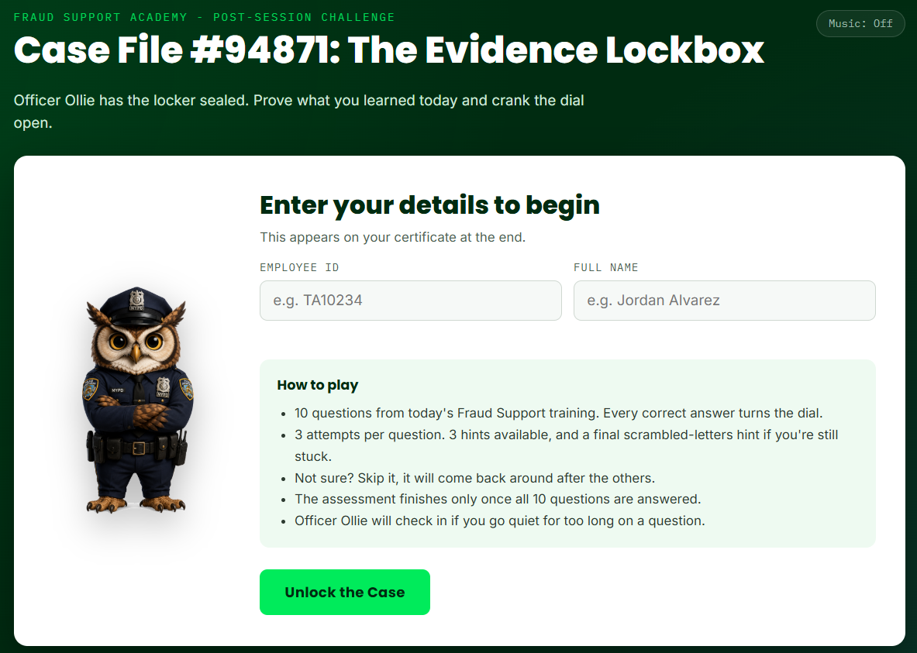
One Last Case
Follow officer Ollie along for the last adventure of the day!
Unlock the case file by answering few simple questions, all based on the knowledge you have gained so far. Each right answer will get you closer to your end goal while the ‘hints’ provide you an extra boost!
Unlock

Slide 15
